Slide 1
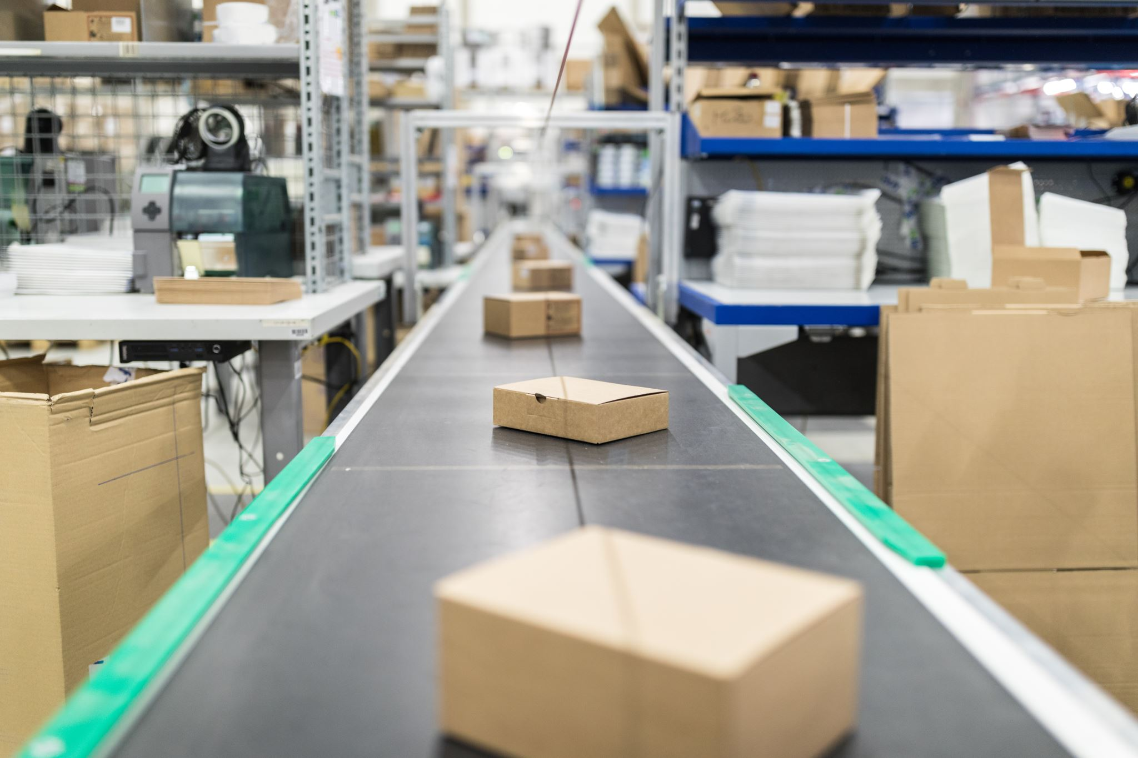
Warehouse Redesign Project
Presented by
Siddhesh Otari
Kartik Joshi
Bennet Sundara Raj
Dasil Davis
Joyel Jose

Slide 2
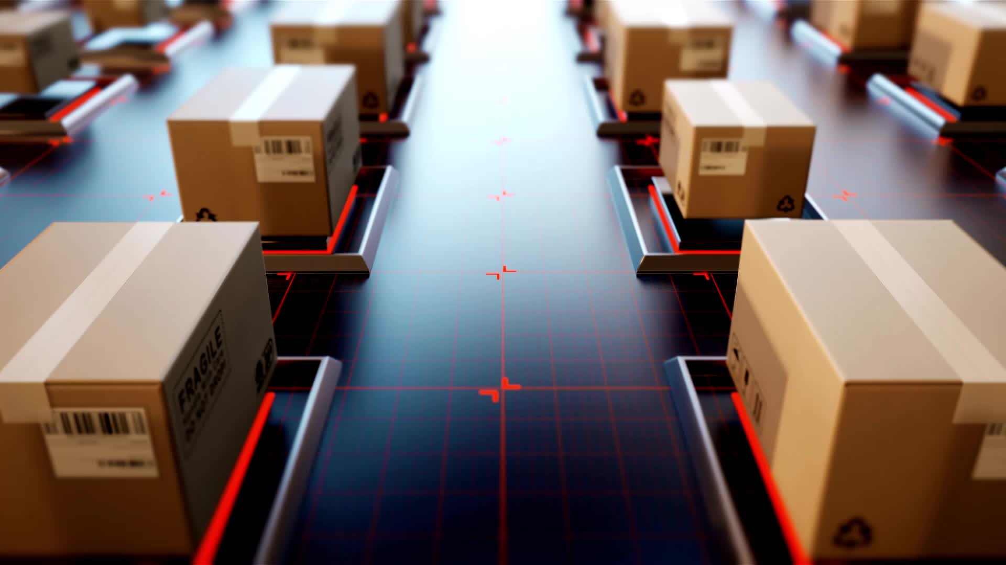
Overview
The city engineering department has deemed the third of a local distribution center dangerous.
Goal: Plan for future expansion of the distribution facility in the same location by shifting one-third of the workload to a third-party warehouse.

Slide 3
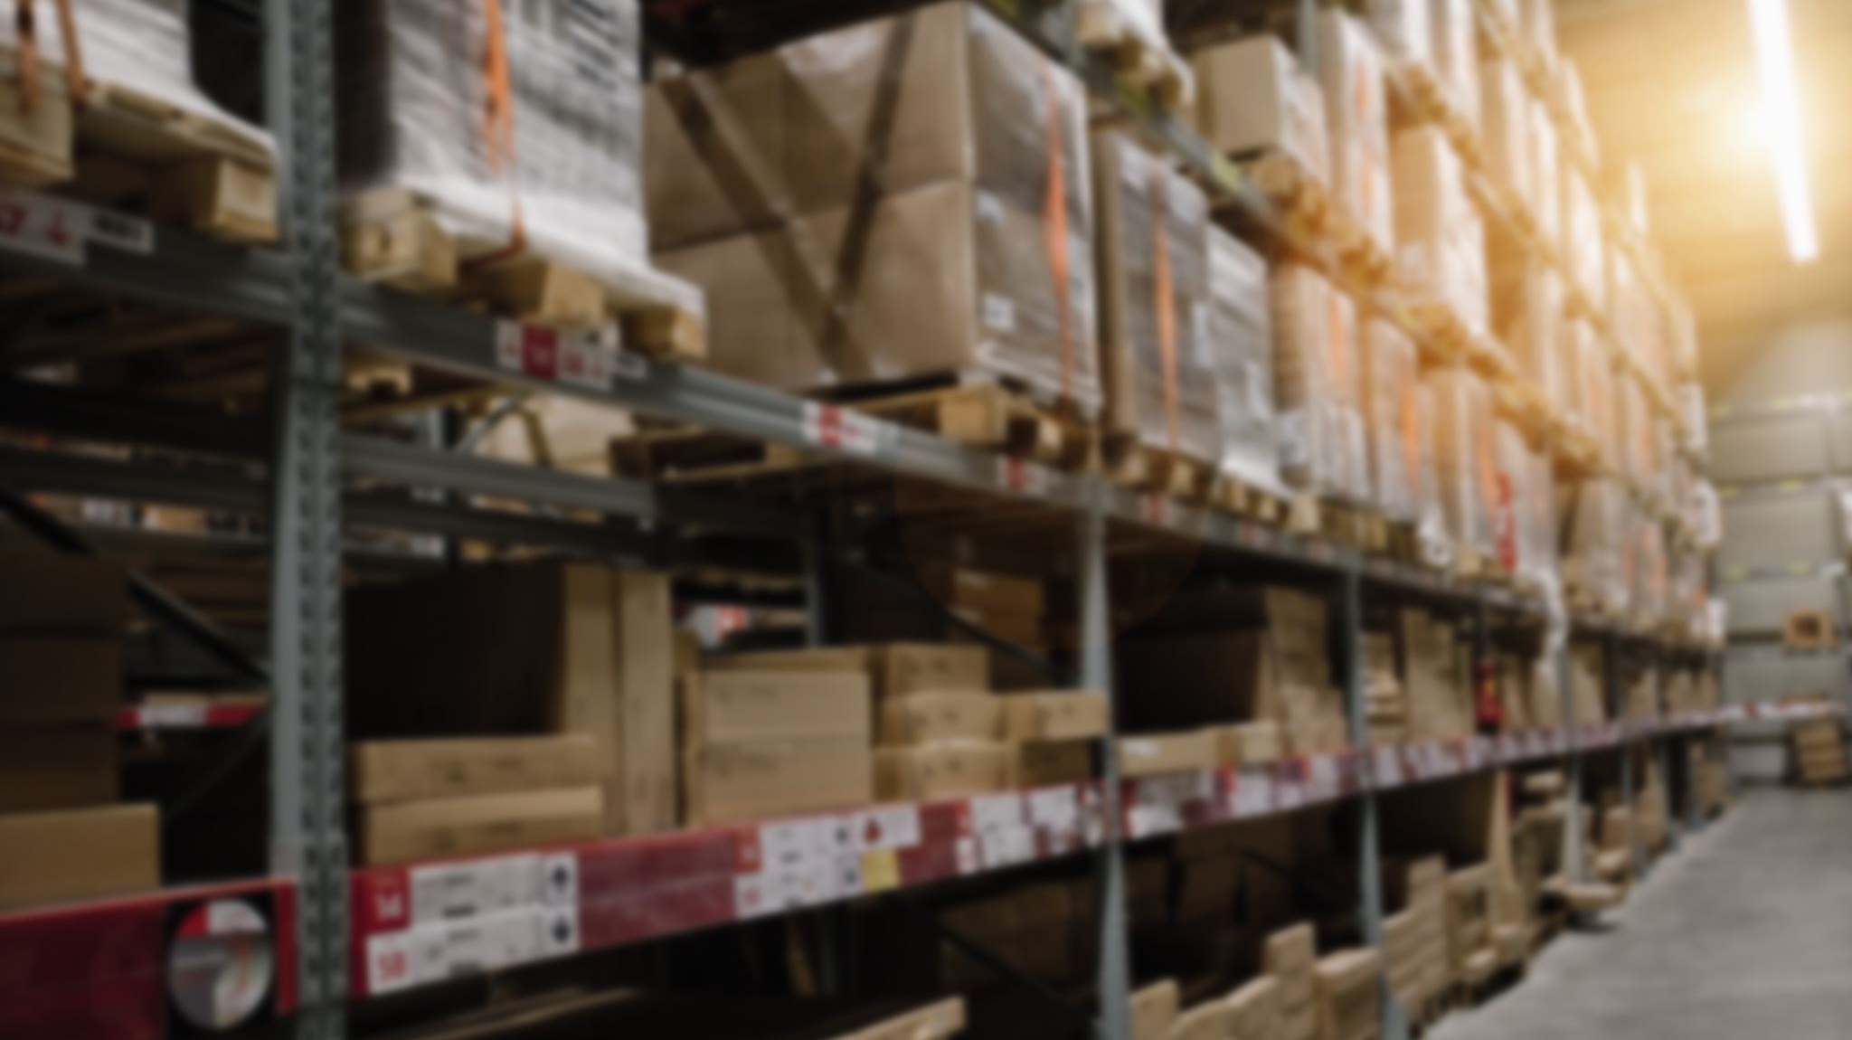
Capacity and Warehouse Selection
Choosing a warehouse in the same city that meets our needs based on research.
The new warehouse is 300,000 square feet and can accommodate 60 trailers for both outbound and incoming freight.
The new warehouse is close to 401 Highway, facilitating transportation and reducing city traffic.

Slide 4

Workforce and Shift Transfer
The current workforce consists of a team leader for operations, team members for quality assurance, security, center riders, reach, and pacer.
Due to the closure of our one-third portion, we have chosen to split up our afternoon shift into two shifts and transfer it to the third-party warehouse.
The afternoon shift will be accommodated in the new location, which will be used for the newly acquired space.

Slide 5

Product Operations and Seasonal Products
The existing warehouse is used to store clothing items, home furnishings, electronics, some furniture, food, office , school supplies, pet food and pet products, toys, household cleaners, and paper goods.
Additional seasonal goods, including Christmas trees, decorations, and wrapping paper, will be available due to the holiday season.
To lessen the picking workload, the new location will emphasize cross-docking.

Slide 6
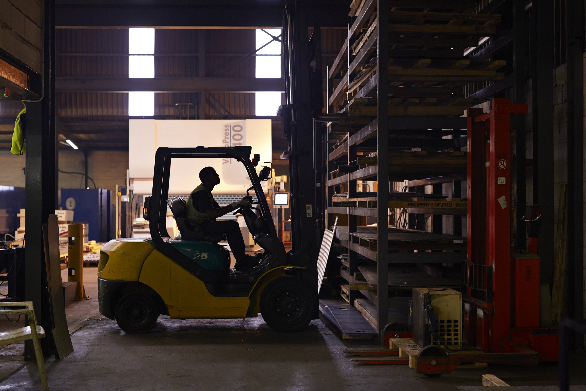
Machinery Transfer and Maintenance
We will use our own fleet, which consists of 25 Centre Riders, 10 Reach, and 15 Pacers, to move some of the apparatus to the new location.
Cross-docking will be our main focus, so the new location will need more pacers than reach machines.
Vendors will provide on-site maintenance for the machinery.

Slide 7

Expansion Plans and Bonus
The management has decided to prepare for the distribution center's future development in the same city.
Employees will receive a bonus for their valuable collaboration and support of the new schedule.

Slide 8
Work Schedule and QA Associate Transfer
The five-day shift plan at the new location will include weekends off.
To ease the burden on current employees, a QA associate who works the night shift in the new warehouse will be transferred.

Slide 9

Inventory Management
Due to the massive workload we anticipate, we have asked the stores to manage any surplus Christmas inventory.
Cross-docking, the process of converting incoming freight into pallets and delivering them to specific stores, will be the main focus of the new location.

Slide 10
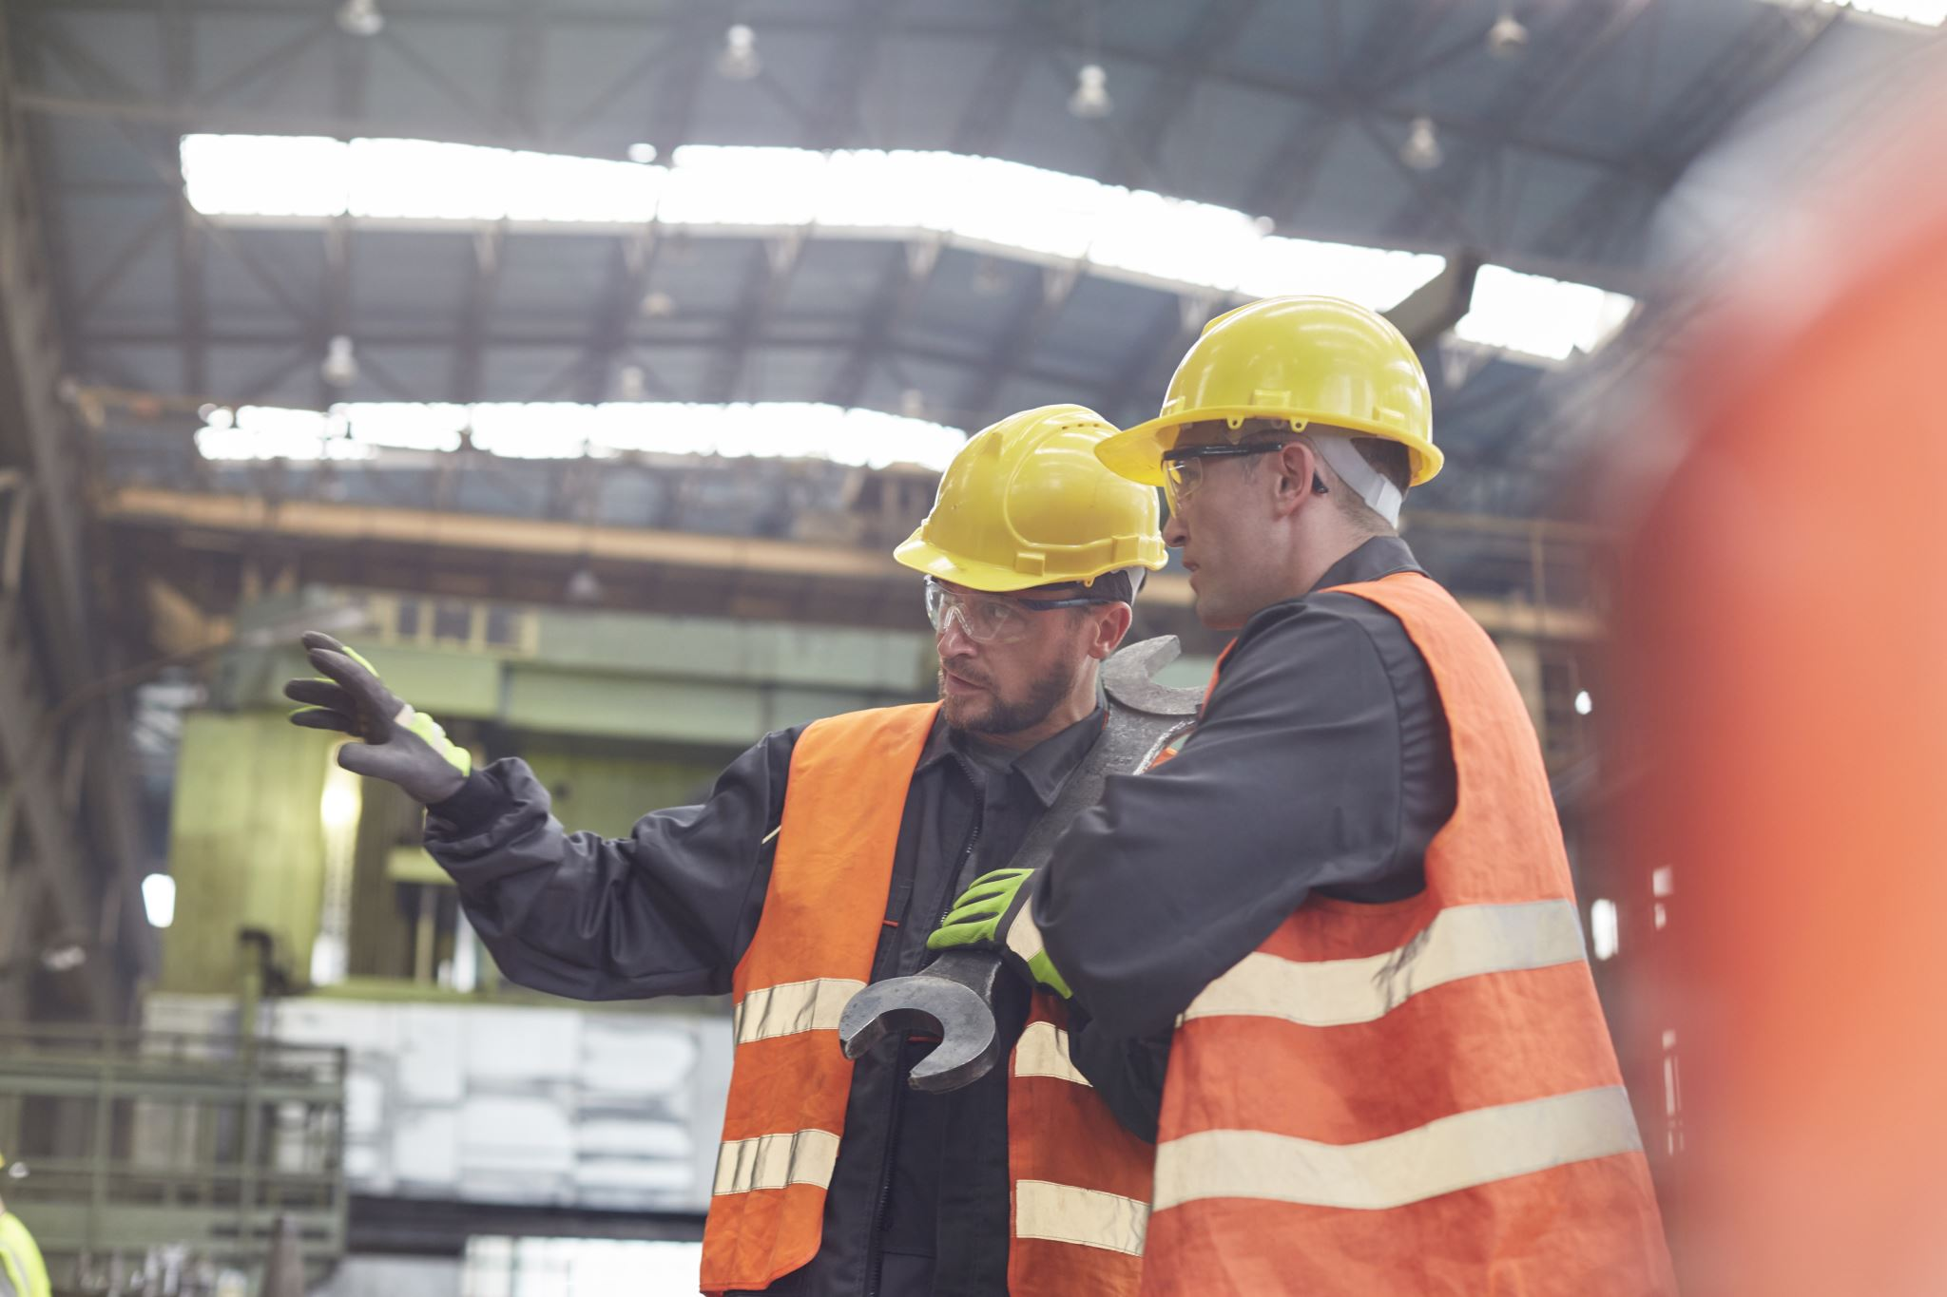
Health and Safety
Our top priority is ensuring the security and safety of our employees.
We'll ensure that the new location complies with all rules and laws on health and safety.

Slide 11
Conclusion
We can plan for future distribution center expansion in the same city thanks to the shift transfer to the new warehouse, which will help us meet seasonal demand.
The management is devoted to guaranteeing a seamless transfer of activities to the new site and to offering a secure working environment for every employee.

Slide 12


Thank you

